Slide 1

Western Minnesota
Hannah DeBruin
Weekly Meeting: Transit Data Subgroup
03/09/23

Slide 2
Project Updates/Timeline
53 paper responses total turned in
still waiting on CCT, United Cap for final submissions
Morris Transit did not have any turned in
Tiffany Collins no longer working for CCT (Donna Anderson replacing her)
Have not heard back from her about scanned copies?
Final survey responses due March 15th
Task 1 report due ?
Weekly Meeting (03/08/2023)
Hannah DeBruin

Slide 3
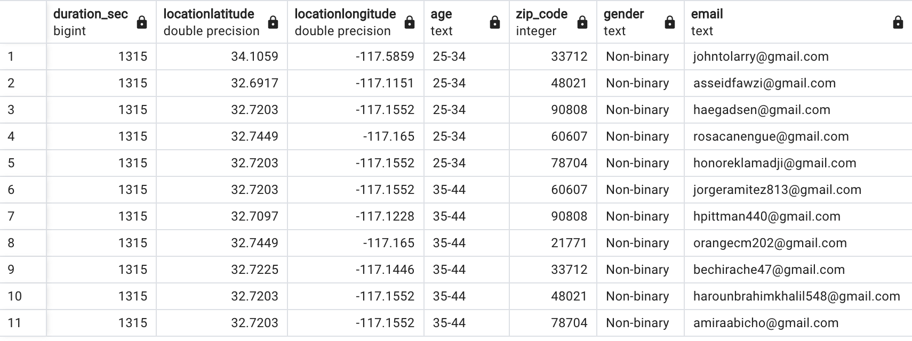
Project Updates/Timeline
Potential Qualtrics response fraud:
Bot responses (identical multiple choice responses taking the same time to complete, coming from same lat/long but different IP addresses)
Responses from outside study area (non-Minnesota zip codes reported)
To counter fraudulent responses, we are filtering Qualtrics data and comparing it to paper responses to determine an acceptable pool of responses
Removing identical responses (likely from bots)
Looking only at MN zip codes, or only at study area zip codes
Applying additional validity filters, ie:
“zip code” and “transit agency” match (by county service area)
“transit agency” and “current fare payment method” match
ie, tokens are not used on Praire Five transit
Weekly Meeting (03/08/2023)
Hannah DeBruin

Slide 4
Survey Response #s – Validity Filters
Transit Agency: | NTD Monthly Avg Ridership | All Qualtrics Responses | Q Unique Responses | Q Mn Zip Codes Only | Q Service Area Zip Codes Only | Q All Filters | Paper
Central Community Transit (CCT) | 17797 | 197 | 172 | 143 | 39 | 1
City of Morris Transit | 4278 | 278 | 221 | 131 | 38 | 6 | 1
None of the above |  | 5 | 5 | 1 | 1 |  | 1
Prairie Five Rides | 11242 | 22 | 17 | 10 | 9 | 1 | 29
Transit Alternatives (Productive Alternatives, The Otter Express) | 7626 | 215 | 160 | 121 | 23 | 4 | 11
Tri-Cap Transit Connection | 10460 | 176 | 153 | 120 | 39 | 15 | 10
United Community Transit | 14384 | 44 | 30 | 16 | 14 | 2 | 1
Sum |  | 937 | 758 | 542 | 163 | 29 | 53

Slide 5
Survey Response #s – Validity Filters
note: missing United, Central paper. No Morris collected

Slide 6
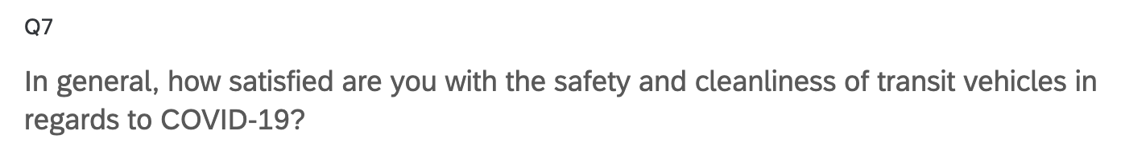
Filter Comparisons – Q7

Slide 7
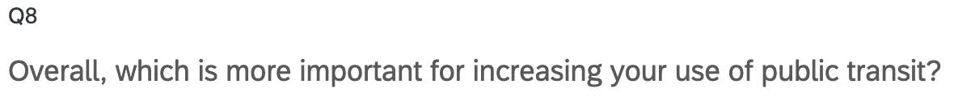
Filter Comparisons – Q8

Slide 8
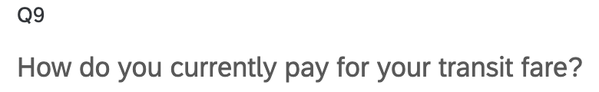
Filter Comparisons – Q9

Slide 9
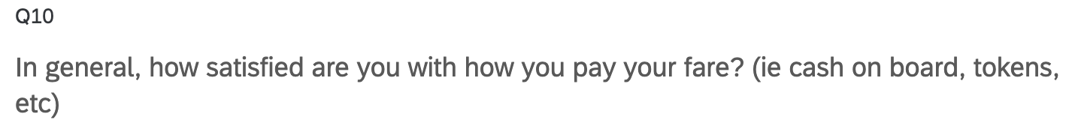
Filter Comparisons – Q10

Slide 10
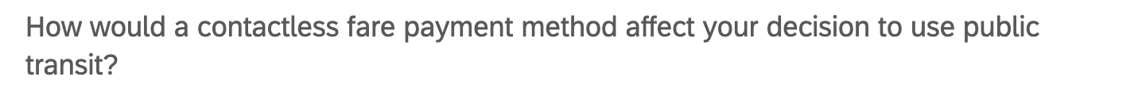
Filter Comparisons – Q11

Slide 11
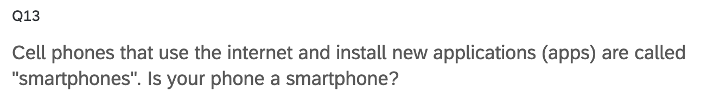
Filter Comparisons – Q13

Slide 12
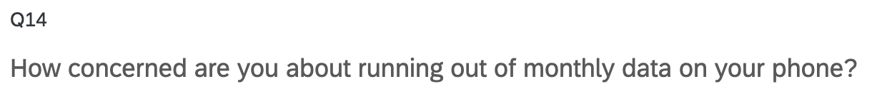
Filter Comparisons – Q14

Slide 13
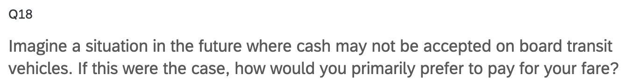
Filter Comparisons – Q18

Slide 14
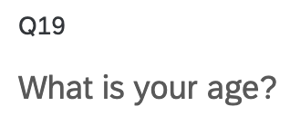
Filter Comparisons – Q19

Slide 15
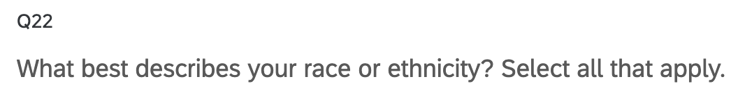
Filter Comparisons – Q22

Slide 16
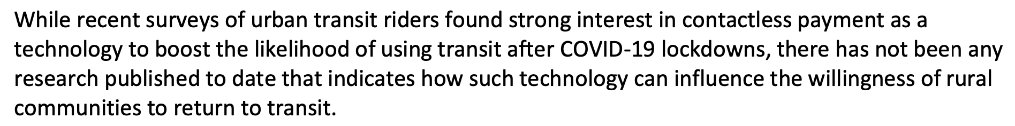
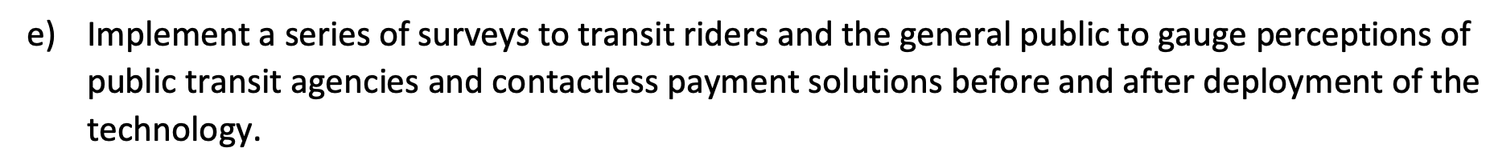
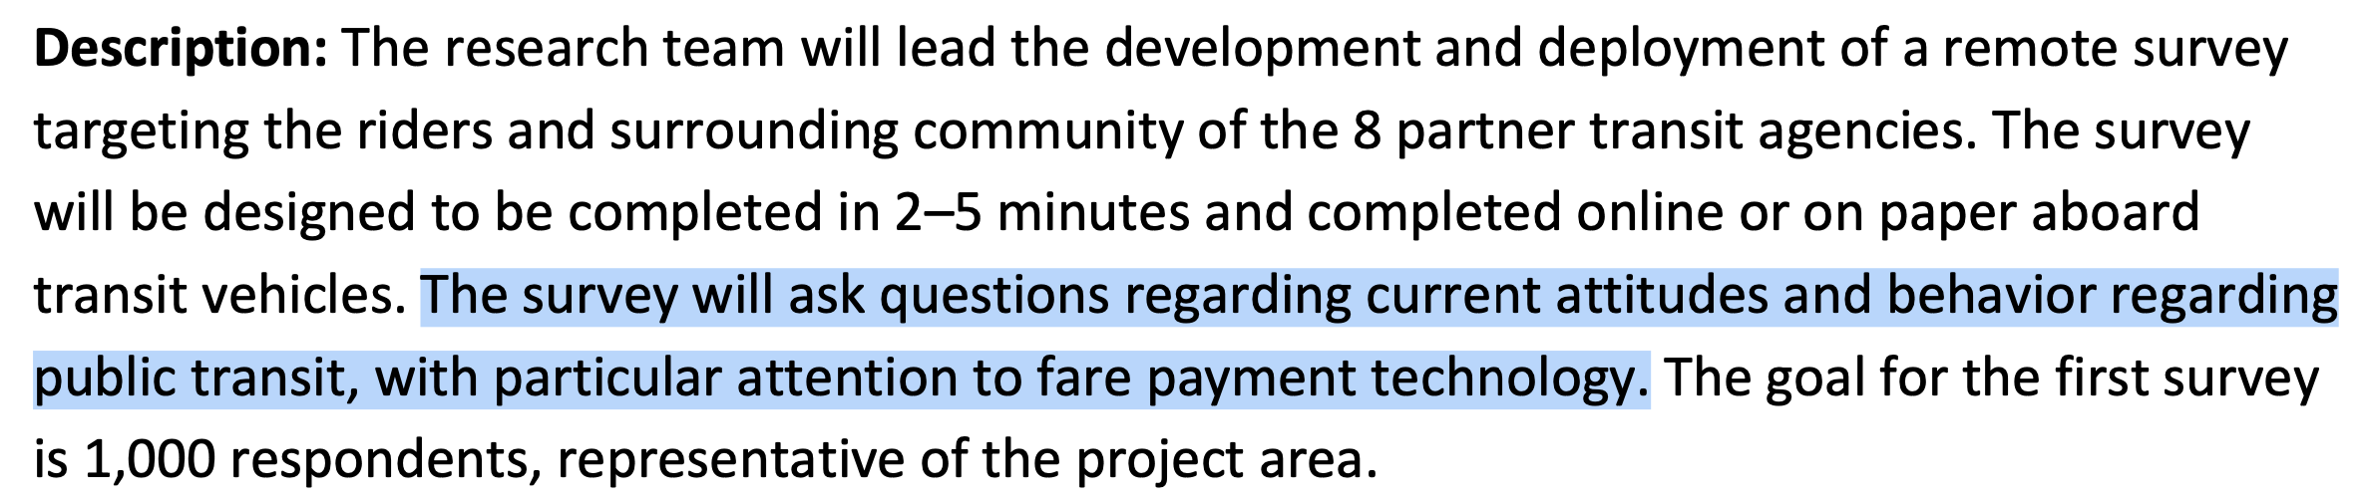
Survey Objectives from Work Plan
Weekly Meeting (03/09/2023)
Hannah DeBruin

Slide 17
Survey Objectives Summarized
Transit usage/behavior, and return post-COVID
Attitudes about transit quality of service
Attitudes about transit COVID safety
Attitudes about fare payment
Attitudes about trip planning
Weekly Meeting (03/09/2023)
Hannah DeBruin

Slide 18
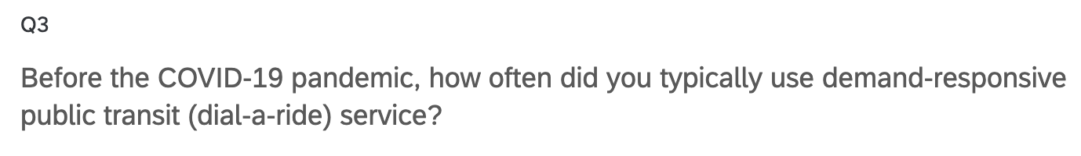
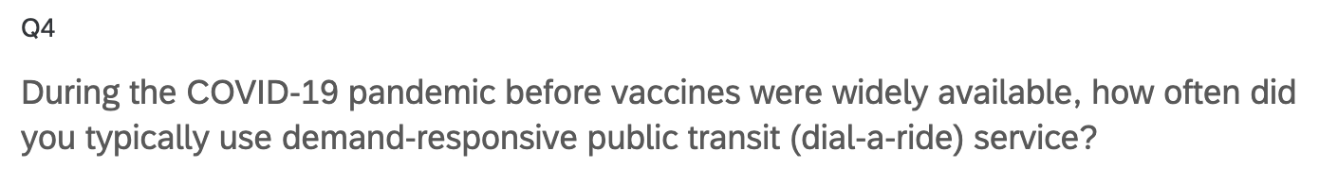
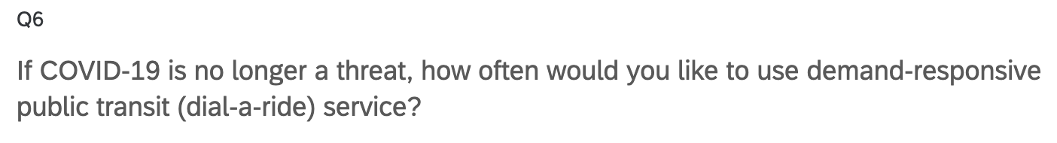
Transit Usage/Behavior and Return post-Covid
Weekly Meeting (03/09/2023)
Hannah DeBruin

Slide 19
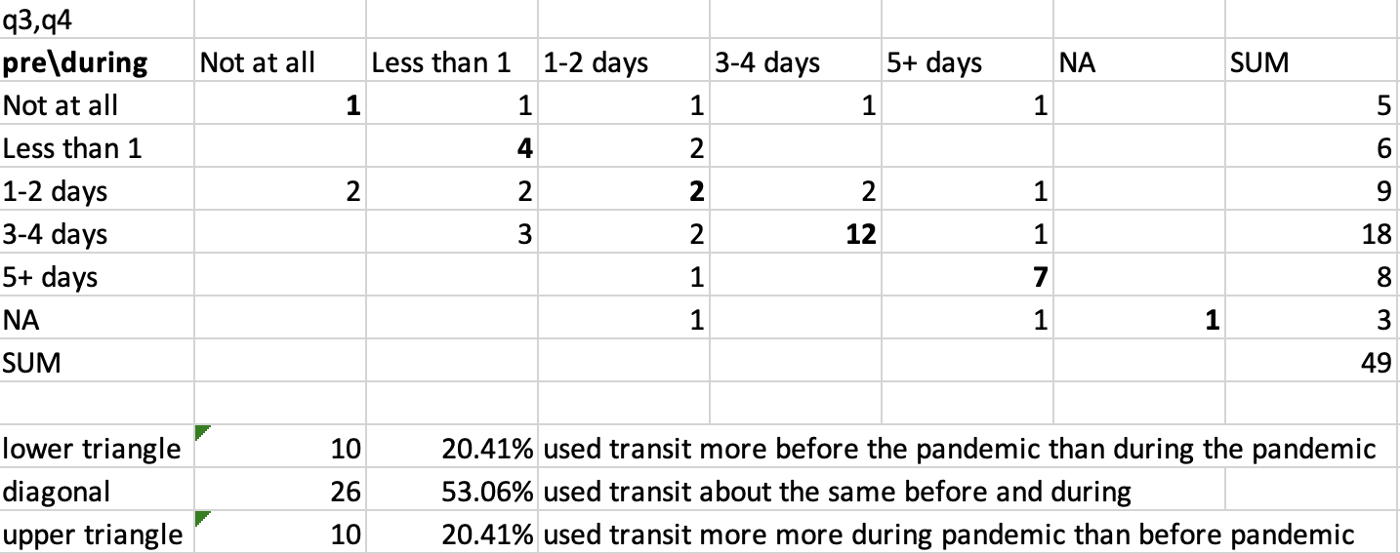
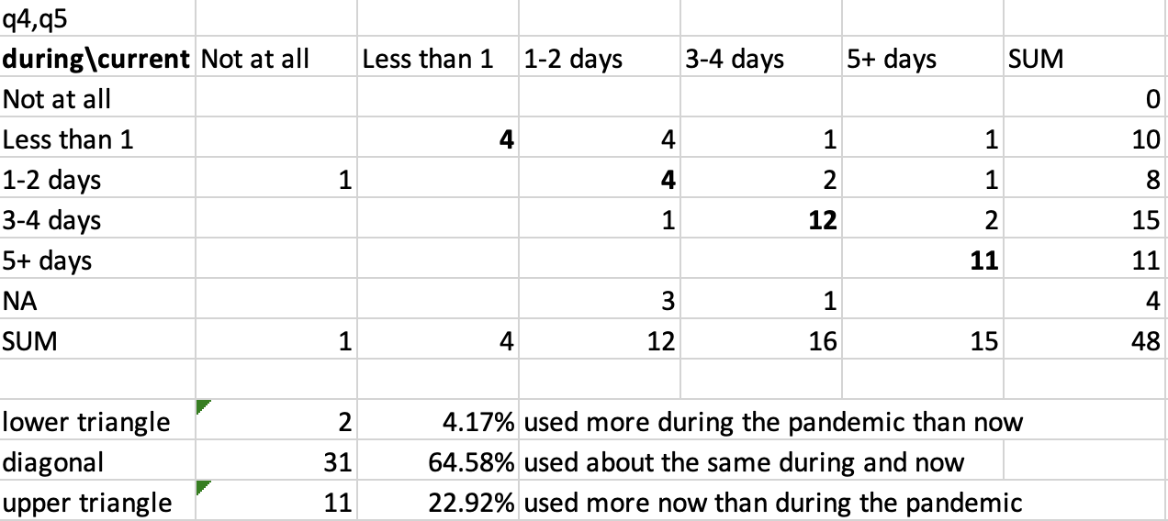
Transit Usage/Behavior and Return post-Covid
Pre-Pandemic v During Pandemic
During Pandemic v Now
Weekly Meeting (03/09/2023)
Hannah DeBruin

Slide 20
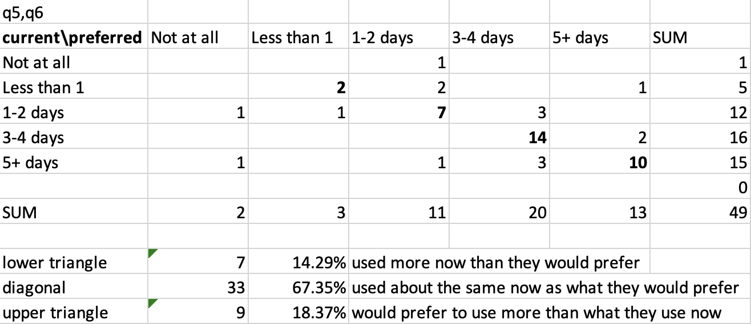
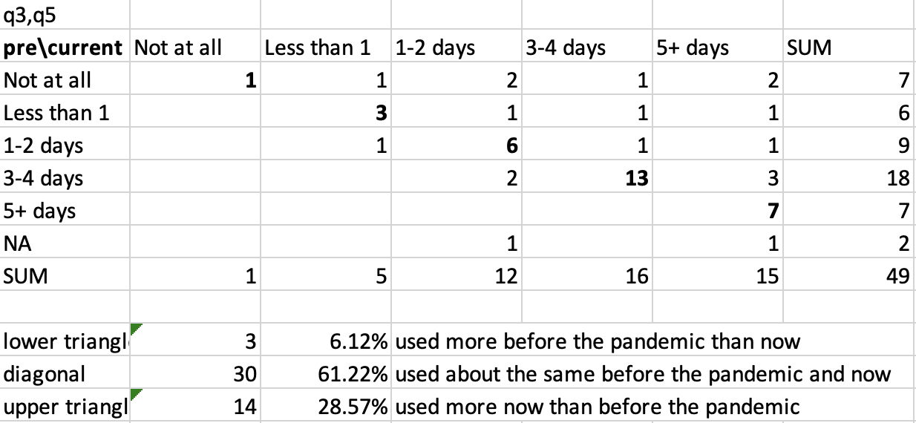
Transit Usage/Behavior and Return post-Covid
Current v Preferred
Pre-Pandemic v Now
Weekly Meeting (03/09/2023)
Hannah DeBruin

Slide 21
Transit Usage/Behavior and Return post-Covid
Weekly Meeting (03/09/2023)
Hannah DeBruin

Slide 22
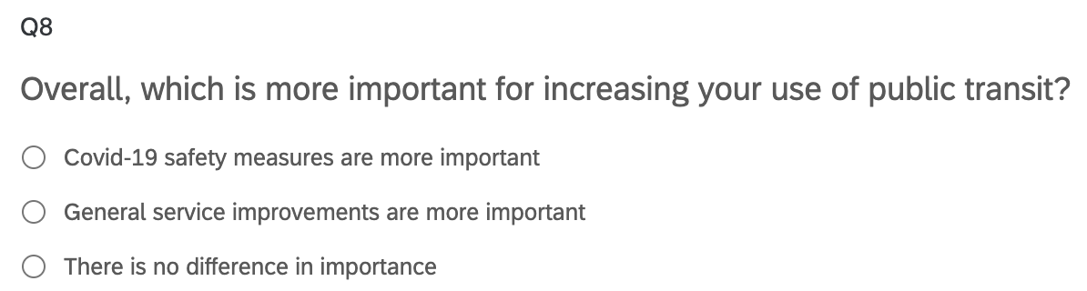
Attitudes about COVID Safety, Quality of Service
Weekly Meeting (03/09/2023)
Hannah DeBruin

Slide 23

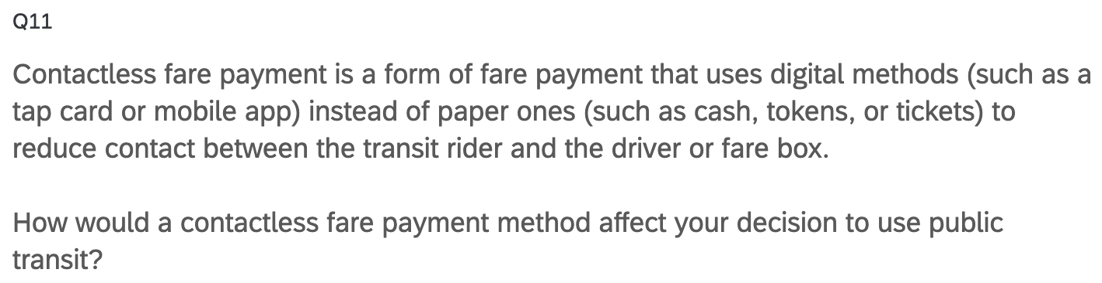
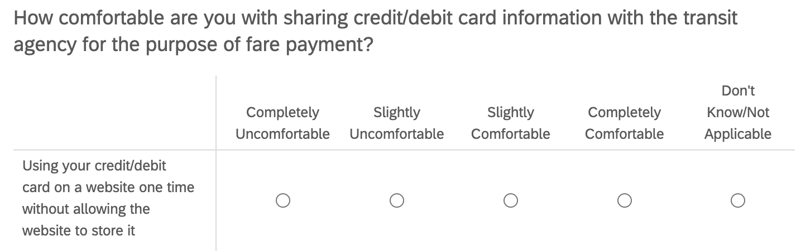
Attitudes about Fare Payment
Q17_1:4
Weekly Meeting (03/09/2023)
Hannah DeBruin

Slide 24
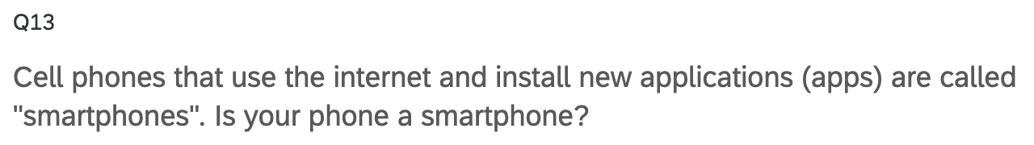
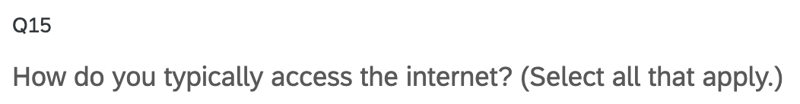
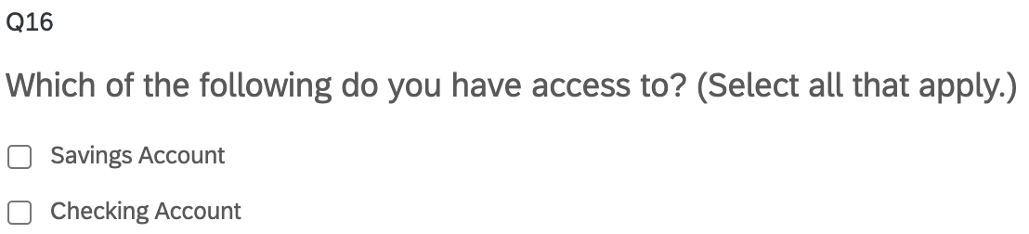
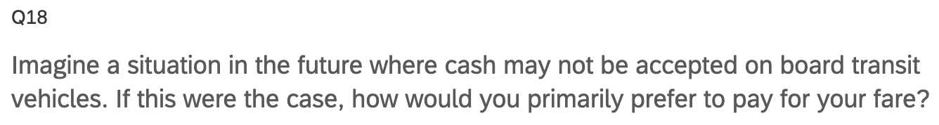
Fare Payment Capabilities
Technology
Payment Method
Weekly Meeting (03/09/2023)
Hannah DeBruin

Slide 25
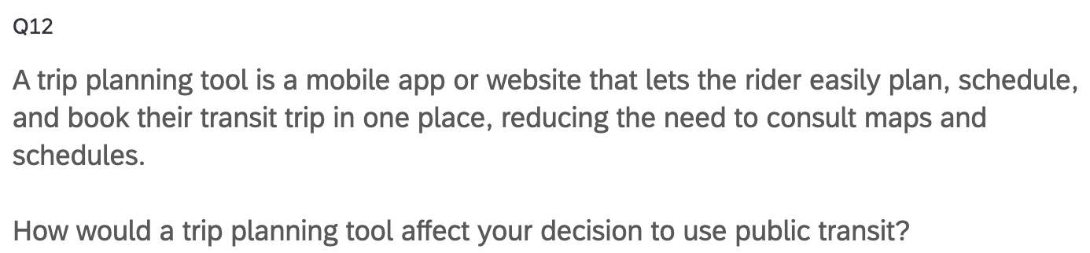
Attitudes about Trip Planning
Weekly Meeting (03/09/2023)
Hannah DeBruin

Slide 26
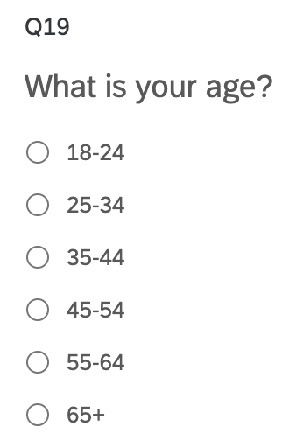
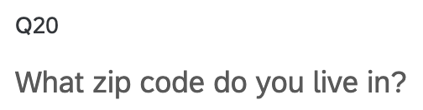
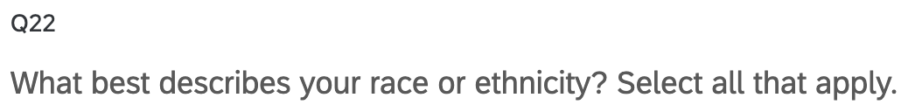
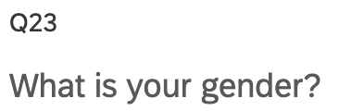
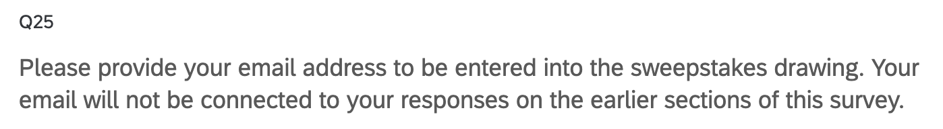
Sociodemographics
Qualtrics also collects:
-duration to complete
-QR code v link
-lat & long
-datetime started, completed
Weekly Meeting (03/09/2023)
Hannah DeBruin

Slide 27
Potential Analysis
Inside Scope of Work:
Satisfaction with fare payment by current fare payment method
Satisfaction with fare payment compared with interest in contactless fare payment
Capabilities for contactless fare payment (ie smartphone, data, payment options) compared with interest in contactless fare payment
Strength of return to transit (frequency of transit use) compared to satisfaction with COVID-19 safety/cleanliness
Strength of return to transit (frequency of transit use) compared to satisfaction with fare payment
Probably don’t want to analyze attitudes specific to a transit provider because of small response rates for some agencies
Could analyze sociodemographic information (ie age, disability, gender, race/ethnicity) compared with attitudes, strength of return to transit (frequency of transit use)
Outside Scope of Work:
Weekly Meeting (03/09/2023)
Hannah DeBruin

